Slide 1
Risk-Aware UAV-UGV periodic Rendezvous
Guangyao Shi

Slide 2
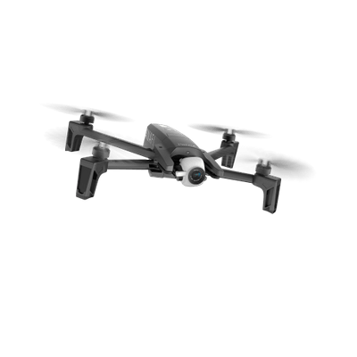
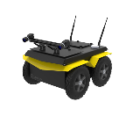
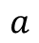
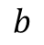
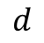
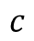
Problem 1
Given a common starting position, the objective of this problem is to find policies for the UAV and the UGV to maximize the collected reward while achieving rendezvous with a high probability before the UAV runs out of energy.
Physical map
$$b$$
Only UAV can visit
$$c$$
$$a$$
$$d$$
Cannot be directly formulated as CMDP due to non-Markovian reward structure

Slide 3
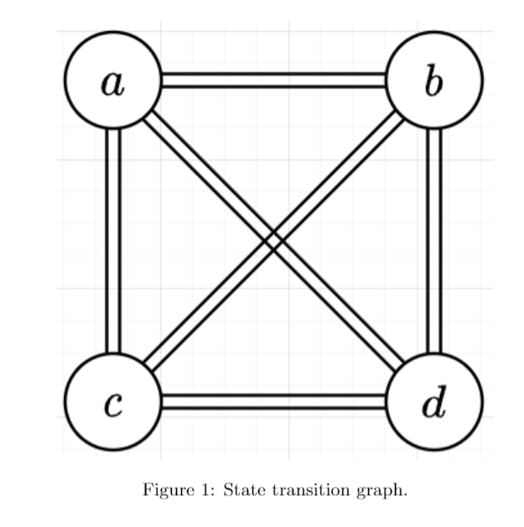
Problem
Reward-collecting type tasks: non-Markovian reward
If robot moves following a−d−c−b−d, the last transition between b and d returns zero reward
if the robot moves following a−c−b−d, it can collect some reward in the transition from b to d

Slide 4
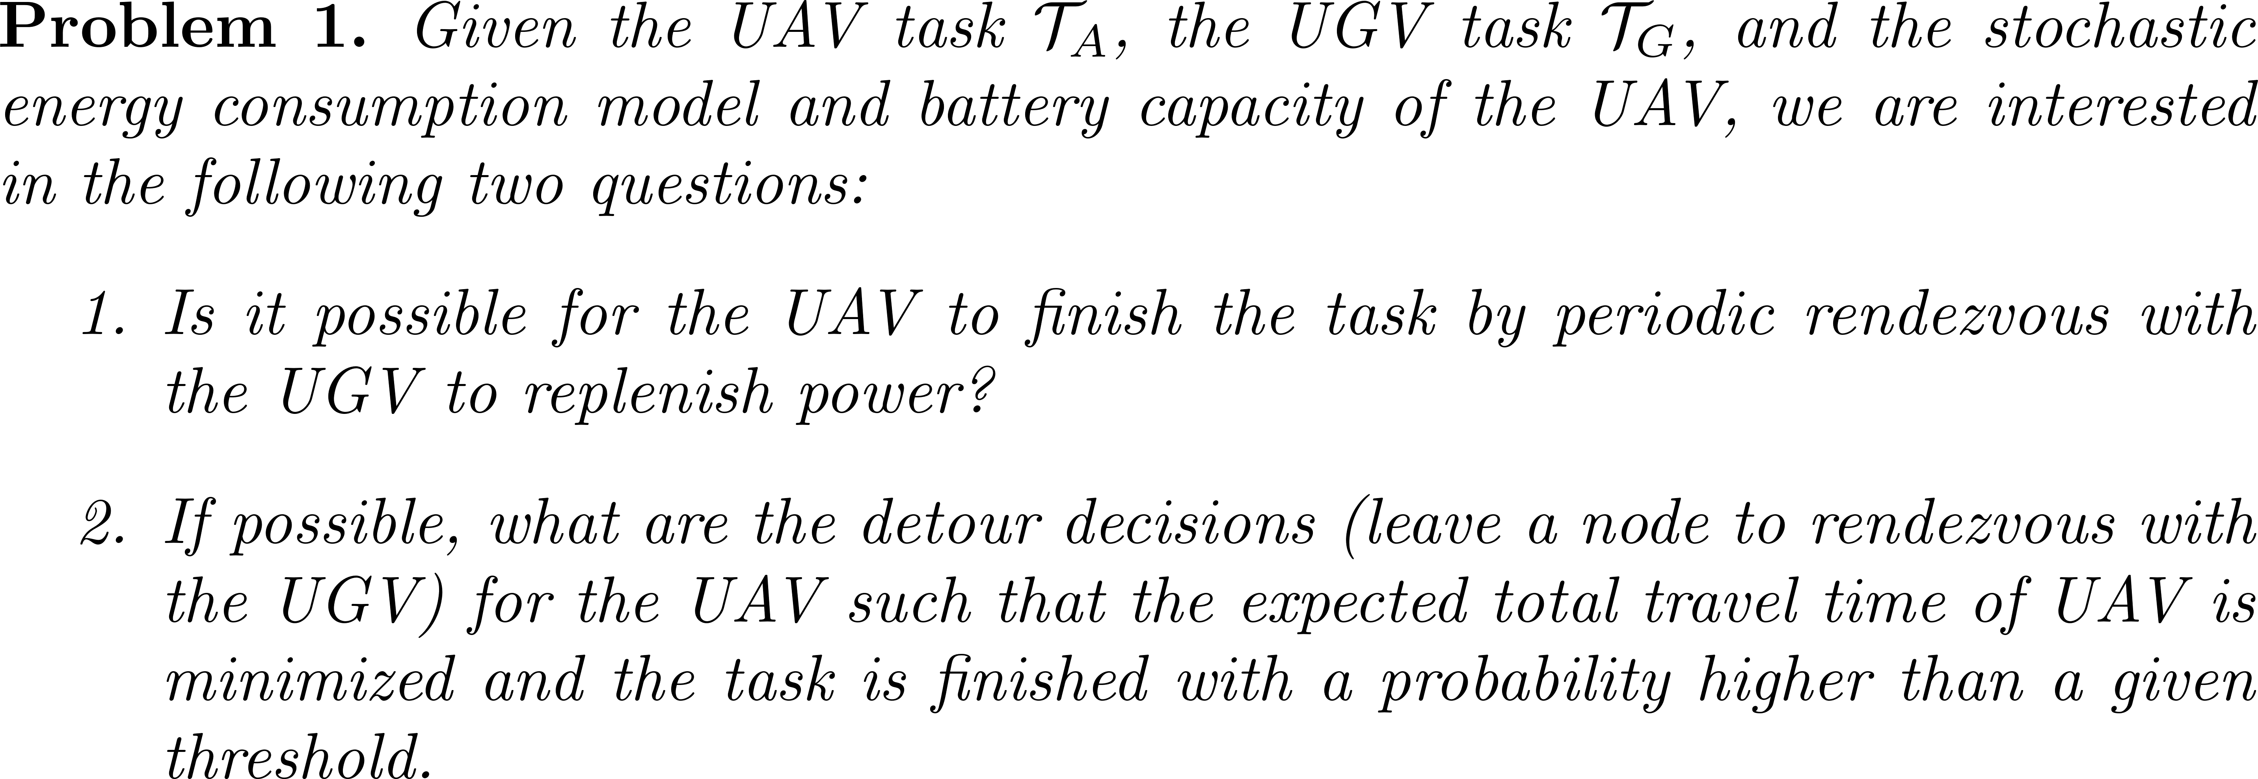
Problem Statement
detour
Notes:
Edges are straight line

Slide 5
Problem setup
Environment
UGV moves on the road
UAV can transit between any two points if energy permits
Motion models: deterministic only for rout planning
UGV moves at either best range speed $v_{br}$ or best endurance velocity $v_{be}$
Energy model: stochastic for time-deterministic route
Task
UGV follows a sequence of nodes and will deviate from the task when receiving rendezvous request
UAV strictly follows an ordered sequence of nodes

Slide 6
Problem setup
Cooperative behavior - rendezvous
detour
At node a, UAV sends a rendezvous request to UGV who is in point c
UGV will do a forward search in the road to find a rendezvous point $\left(p_{r}, t_{r}\right)$
Minimize max(T(a, $p_{r}$), T(c, $p_{r}$)) + T($p_{r}$, b)
(T(a, $p_{r}$): time needed for UAV to go to rendezvous point $p_{r}$
(T(c, $p_{r}$): time needed for UGV to go to rendezvous point $p_{r}$
(T($p_{r}$, b): time needed for UAV to go back to task
Assume constant time for recharging

Slide 7
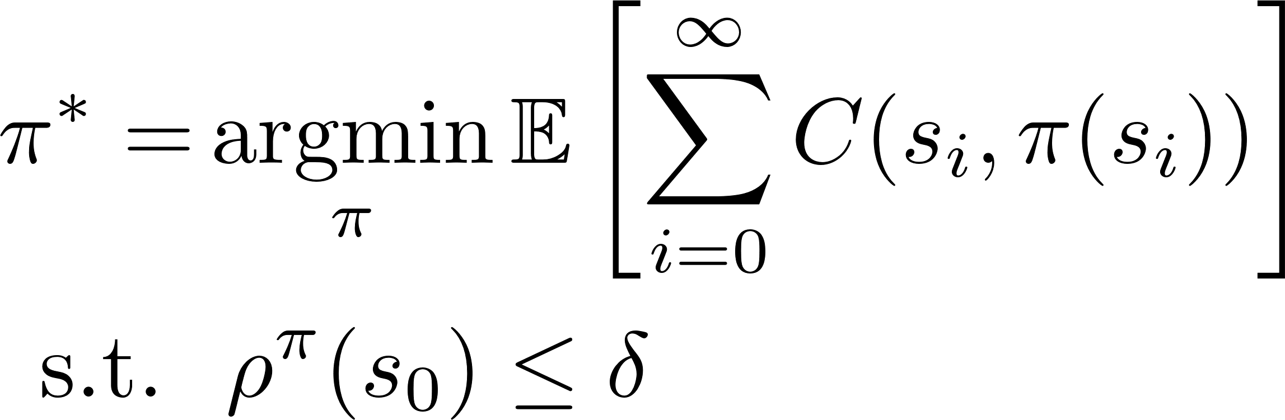
Chance Constrained MDP
Minimize the expected task duration
State space:
Action space:
Move forward with best range speed
Rendezvous with best range speed
Move forward with best endurance speed
Rendezvous with best endurance speed
Risk is defined as the probability of entering the failure state
Transform CCMDP to Constrained MDP

Slide 8
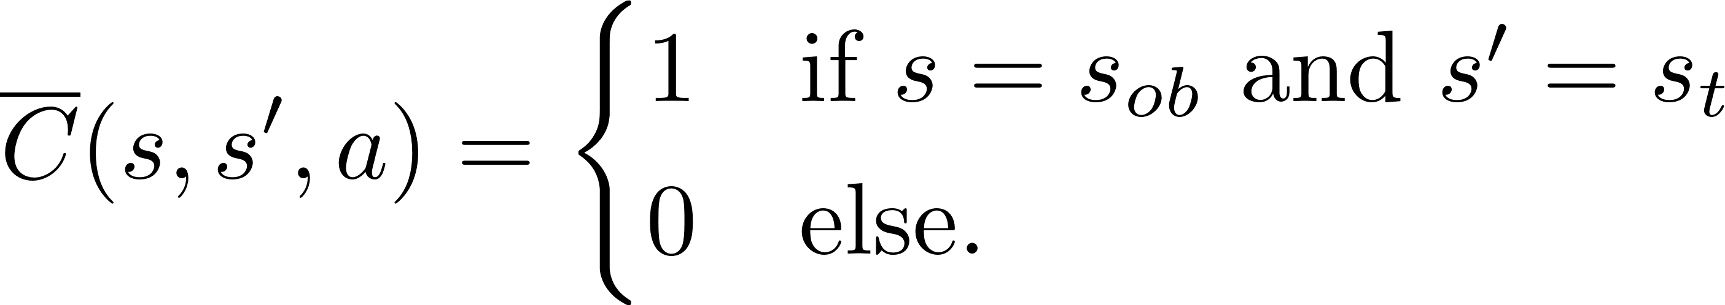
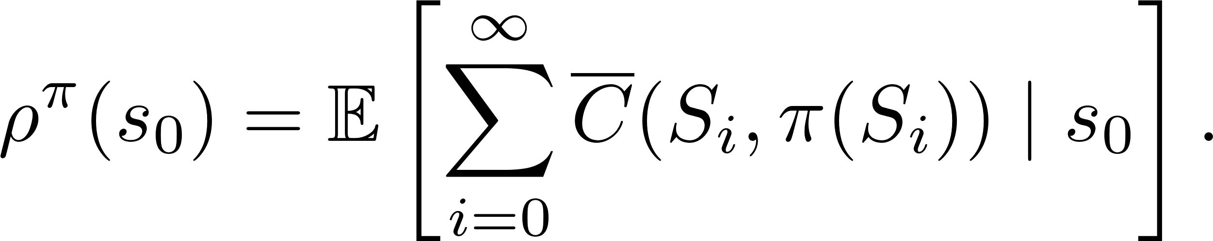
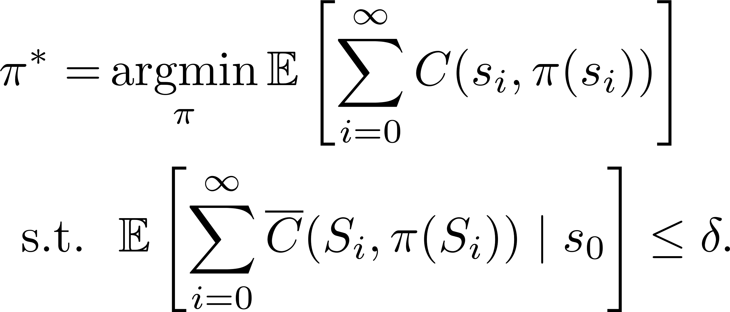
Constrained MDP
CMDP formulation

Slide 9
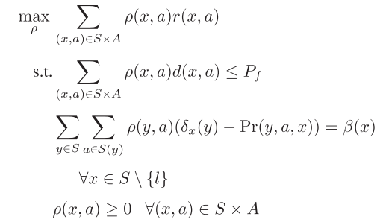


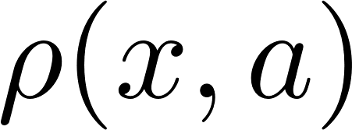
Constrained MDP
Dynamic programming
Heuristic search
Linear Program
Occupancy measure describing how many time on average an action is taken at a given state

Slide 10
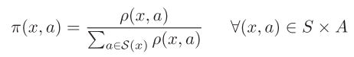
Constrained MDP
Linear Program
Construct policy from occupancy measure

Slide 11
Problem setup
Cooperative behavior - recharge
detour
Swap battery -- constant time
Mobile charging -- charging time is decided by energy left and need to think about how UGV moves and its effect on the UAV task

Slide 12
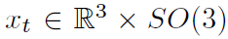
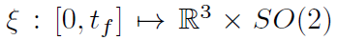
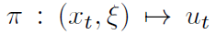
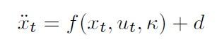
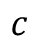
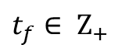
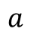
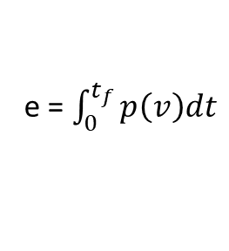
How to incorporate energy uncertainty?
$$a$$
$$c$$
Each transition is represented by a trajectory and the corresponding controller
$t_{f}∈ Ζ_{+}$
Unit second
Energy consumption distribution
We can get energy distribution for each discrete time step
Forward simulation and record a set of trajectories
e = $\int_{0}^{t_{f}}{p\left(v\right)dt}$
Compute energy

Slide 13
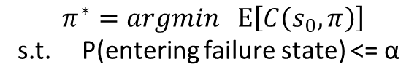
CCMDP based formulation
rendezvous
next
CCMDP:
State: UAV, UGV, energy
Action: rendezvous or next
Cost: time consumed for transition
Failure state
$$π^{∗}=argmin Ε\left[C\left(s_{0}, π\right)\right]$$
s.t. P(entering failure state) <= α

Slide 14
Problem 2
Key is to rendezvous periodically for the long-term operation
Simpler problem: suppose the task path of the UGV is given, a sequence of nodes that the UAV should visit is also given. Considering the limited energy of the UAV, we want to answer the questions:
Is it possible for the UAV to finish the path by periodic rendezvous with the UGV to replenish power?
If possible, what are the detour decisions (leave a node to rendezvous with the UGV) for the UAV such that the total travel time of UAV and energy chance constrains is satisfied during the task.
detour
Notes:
Edges are straight line

Slide 15
CCMDP based formulation
Overleaf formulation
Questions
Is this a standard CMDP?
State: UAV (discrete), UGV (discrete but large), energy(continuous)
How to solve it?
Linear programming
Dynamic programming
MCTS-based

Slide 16
CCMDP based formulation
Offline or online?
detour
Back to the original question: is it possible to finish the path for the UAV? (Offline solution can answer this by a single run)
UAV can fly for only for about 20 minutes. Does it have enough computational power to finish decision-making in a few seconds when it reaches a node?

Slide 17
Problem 2
Key is to rendezvous periodically for the long-term operation
Simpler problem: suppose the task path of the UGV is given, a sequence of nodes that the UAV should visit is also given. Considering the limited energy of the UAV, we want to answer the questions:
Is it possible for the UAV to finish the path by periodic rendezvous with the UGV to replenish power?
If possible, what are the detour decisions (leave a node to rendezvous with the UGV) for the UAV such that the total travel time of UAV and energy chance constrains is satisfied during the task.
detour
Notes:
Edges are straight line

Slide 18
MCTS based algorithm

Slide 19
Test case

Slide 20
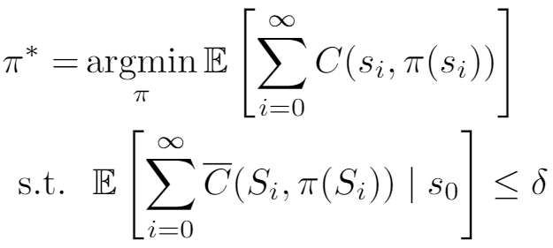


Results and problems
Very risk-sensitive to collision
Less risk-sensitive to collision

Slide 21
Example 1 CMDP
Low risk
High risk

Slide 22
Different MDPs
Infinite horizon MDP
Finite horizon MDP
Indefinite MDP (e.g., stochastic shortest path)
Our problem
Chance-constrained SSP with dead ends
Constrained SSP with dead ends
A special structure and previous test case is not a good choice

Slide 23
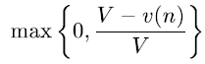
MCTS
MCTS will converge to optimal solution under some conditions
Usually work with together with heuristic
A popular heuristic Rapid Action Value Estimation

Slide 24


Rendezvous example
(Top-down view)
UAV
UGV
UAV actions at each node:
Move to next task with best endurance velocity
Move to next task with best range velocity
Rendezvous with and return to task with
Rendezvous with and return to task with
Rendezvous with and return to task with
Rendezvous with and return to task with
Stochastic power consumption model
Notes:
Parameters, Input map: some file
Continuous state
Collision state penalty?

Slide 25

Test case
Going into collision state incurs D cost

Slide 26
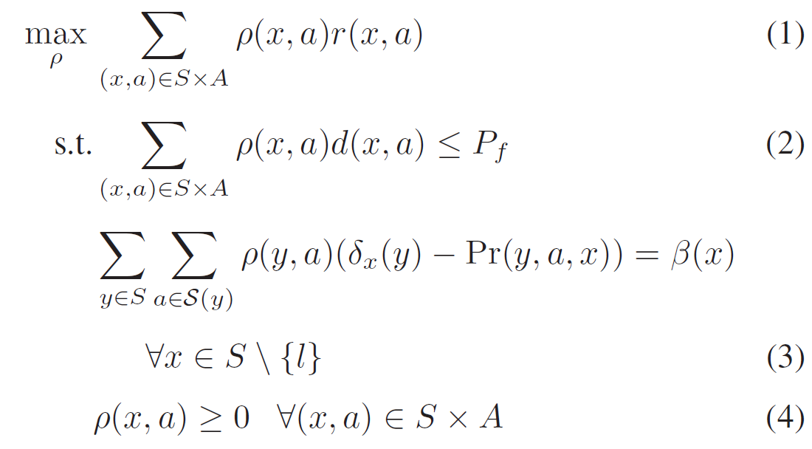
MCTS-based method doesn’t work well
LP-based methods

Slide 27
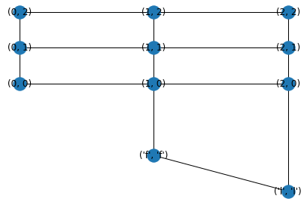
LP test
Efficient for small problems

Slide 28
Rendezvous example
(Top-down view)
UAV
UGV
Notes:
Parameters, Input map: some file
Continuous state
Collision state penalty?

Slide 29

Problems with previous formulation: non-Markovian
Cannot decide transition with this state alone
Rendezvous will change UGV’s path
After rendezvous, the transition may
be non-decidable
Notes:
Parameters, Input map: some file
Continuous state
Collision state penalty?

Slide 30
Problem 3
given a graph, there are some rendezvous nodes in which UAV can land on UGV. UAVs will appear in those nodes stochastically due to task and energy-management and the inter-arrival time is decided by the energy consumption, which is also stochastic. UGV travels on the graph to provide power and the travel time may be stochastic for each edge. Research question is what is the minimum number of UGVs and their routes such that the waiting time of each UAV in the rendezvous nodes is less than T with high prob.

Slide 31
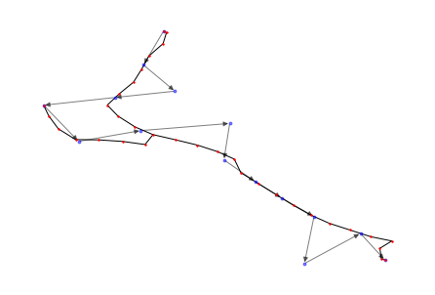

Problems with
detour
state space size?
15 x 34 x 25 x 3 = 38250
Notes:
Parameters, Input map: some file
Continuous state
Collision state penalty?

Slide 32
Linear Programming implementation for the CMDP instance - completed
Tested on an instance with 15 sites that UAS needs to visit and a UGV path
Will show a representative policy with probability of failure <= 0.1
Pareto-optimal plot showing expected mission time (primary objective) versus probability of failure constraint
Discussion
Modifications to the instance
More analysis needed
Notes:
Parameters, Input map: some file
Continuous state
Collision state penalty?

Slide 33
Rendezvous case study
UAV and UGV start here
UAV and UGV start here
Nodes in road network are denoted as red dots
UAV task is specified as directed line graph
Notes:
Parameters, Input map: some file
Continuous state
Collision state penalty?

Slide 34
Rendezvous case study
One sample trajectory for c = 0.1
V_be: move to next task node with best endurance velocity
V_br: move to next task node with best range velocity
V_be_be: rendezvous with best endurance velocity
V_br_br: rendezvous with best range velocity
Battery level: 100 units divided into 25 pieces
Notes:
Parameters, Input map: some file
Continuous state
Collision state penalty?

Slide 35
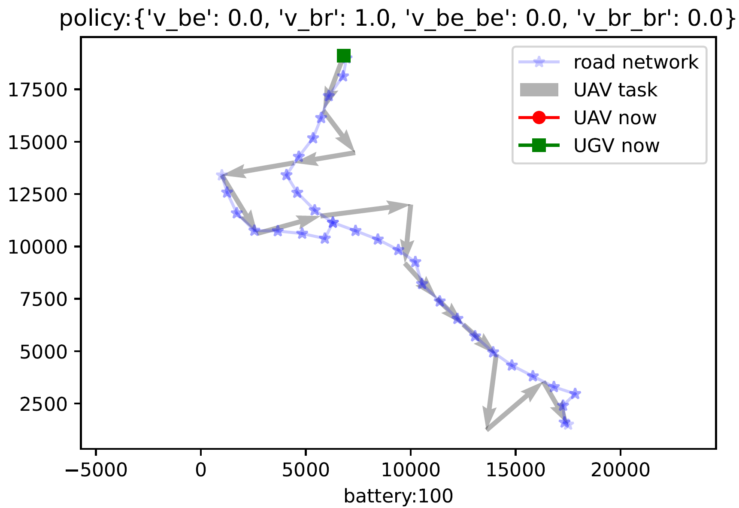
Rendezvous case study
One sample trajectory for c = 0.1
Notes:
Parameters, Input map: some file
Continuous state
Collision state penalty?

Slide 36
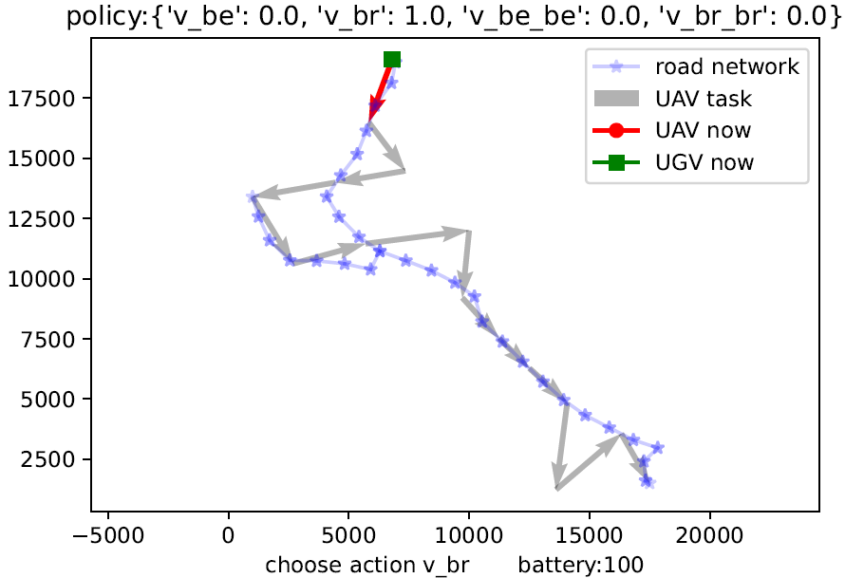
Rendezvous case study
One sample trajectory for c = 0.1
Notes:
Parameters, Input map: some file
Continuous state
Collision state penalty?

Slide 37
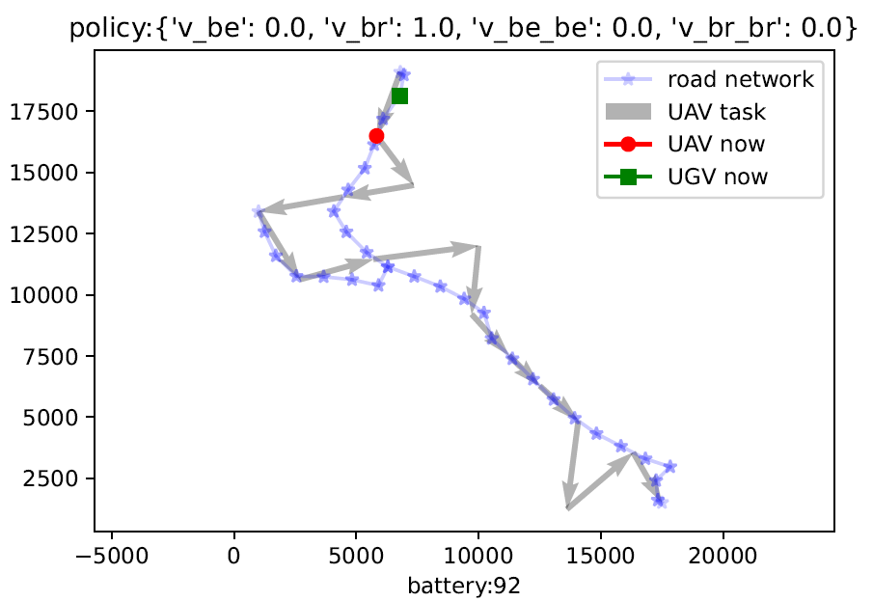
Rendezvous case study
One sample trajectory for c = 0.1
Notes:
Parameters, Input map: some file
Continuous state
Collision state penalty?

Slide 38
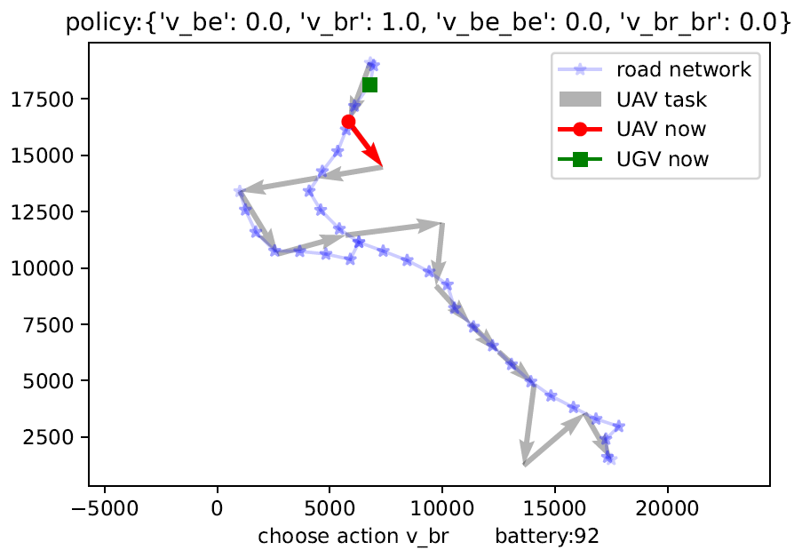
Rendezvous case study
One sample trajectory for c = 0.1
Notes:
Parameters, Input map: some file
Continuous state
Collision state penalty?

Slide 39
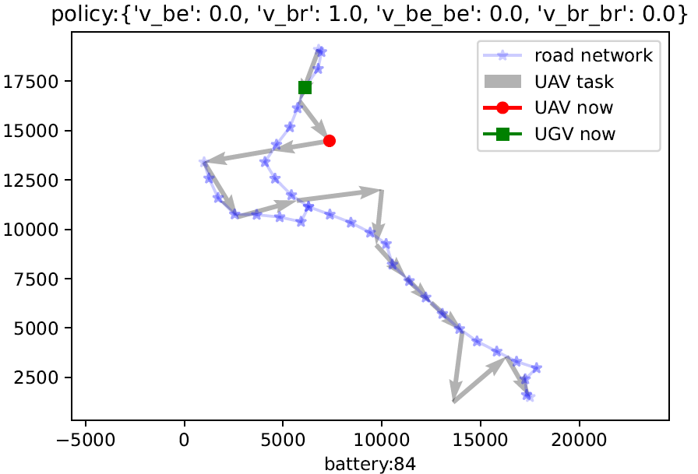
Rendezvous case study
One sample trajectory for c = 0.1
Notes:
Parameters, Input map: some file
Continuous state
Collision state penalty?

Slide 40
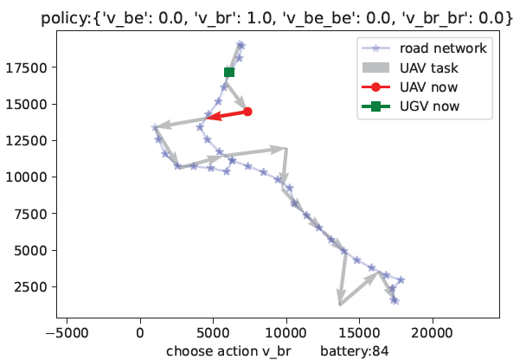
Rendezvous case study
One sample trajectory for c = 0.1
Notes:
Parameters, Input map: some file
Continuous state
Collision state penalty?

Slide 41
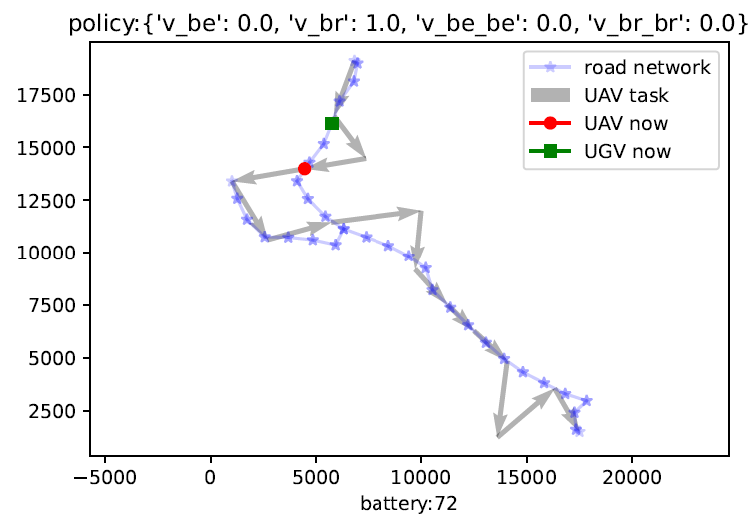
Rendezvous case study
One sample trajectory for c = 0.1
Notes:
Parameters, Input map: some file
Continuous state
Collision state penalty?

Slide 42
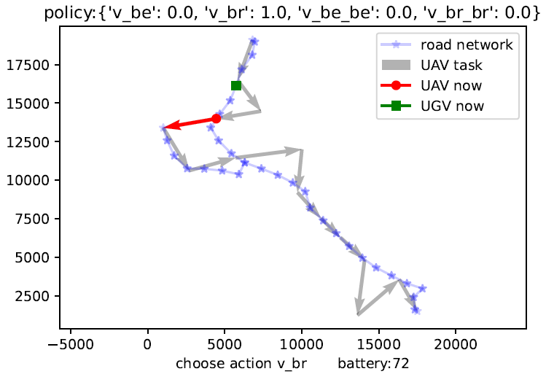
Rendezvous case study
One sample trajectory for c = 0.1
Notes:
Parameters, Input map: some file
Continuous state
Collision state penalty?

Slide 43
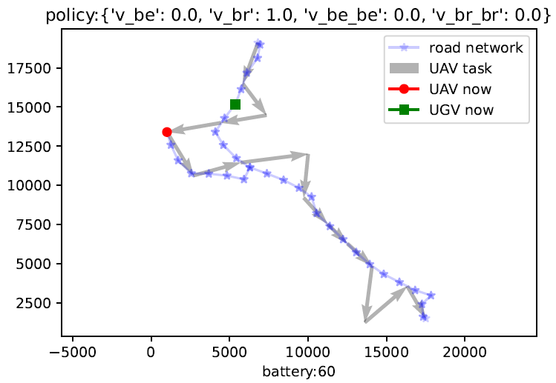
Rendezvous case study
One sample trajectory for c = 0.1
Notes:
Parameters, Input map: some file
Continuous state
Collision state penalty?

Slide 44
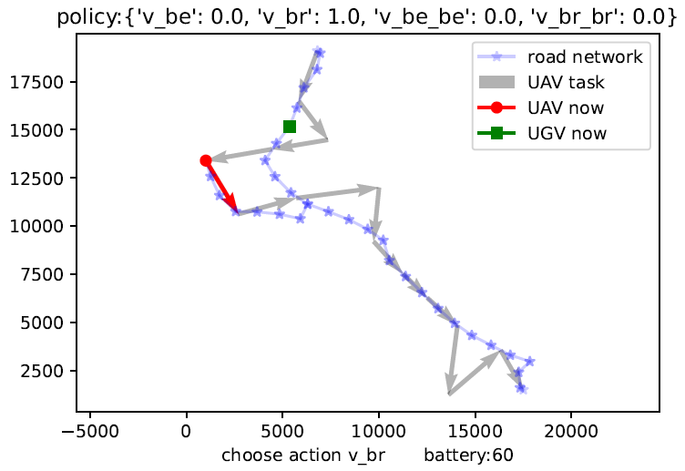
Rendezvous case study
One sample trajectory for c = 0.1
Notes:
Parameters, Input map: some file
Continuous state
Collision state penalty?

Slide 45
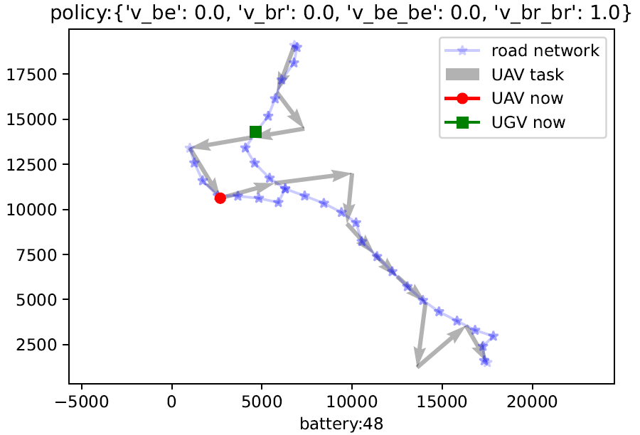
Rendezvous case study
One sample trajectory for c = 0.1
Notes:
Parameters, Input map: some file
Continuous state
Collision state penalty?

Slide 46
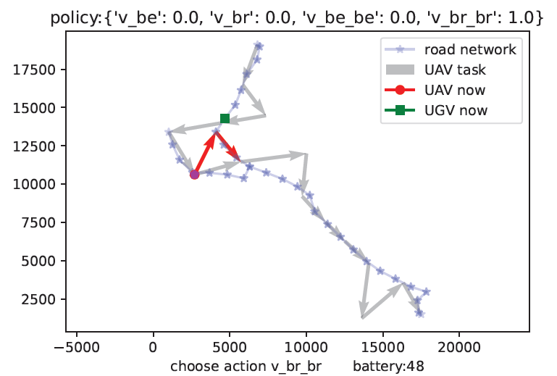
Rendezvous case study
One sample trajectory for c = 0.1
Notes:
Parameters, Input map: some file
Continuous state
Collision state penalty?

Slide 47
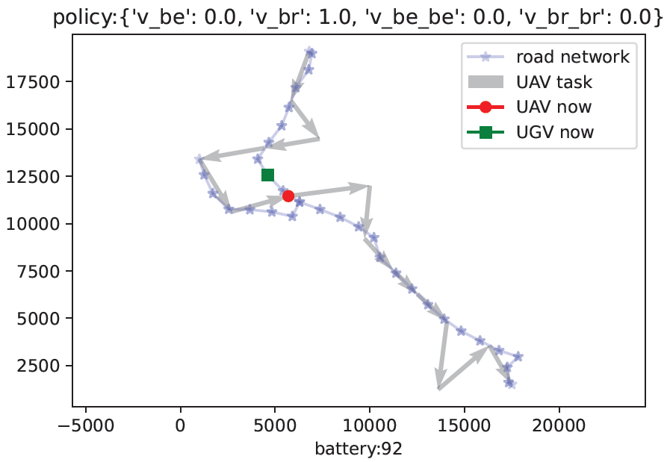
Rendezvous case study
One sample trajectory for c = 0.1
Notes:
Parameters, Input map: some file
Continuous state
Collision state penalty?

Slide 48
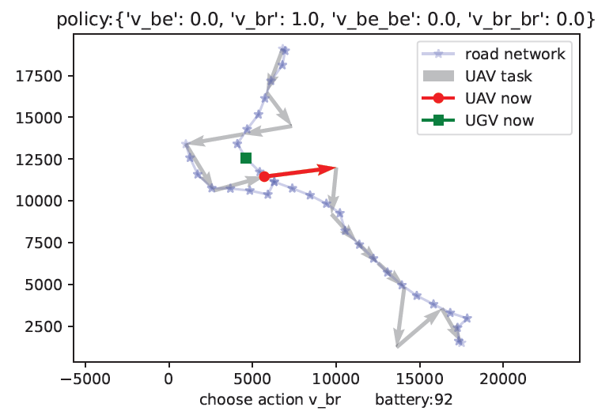
Rendezvous case study
One sample trajectory for c = 0.1
Notes:
Parameters, Input map: some file
Continuous state
Collision state penalty?

Slide 49
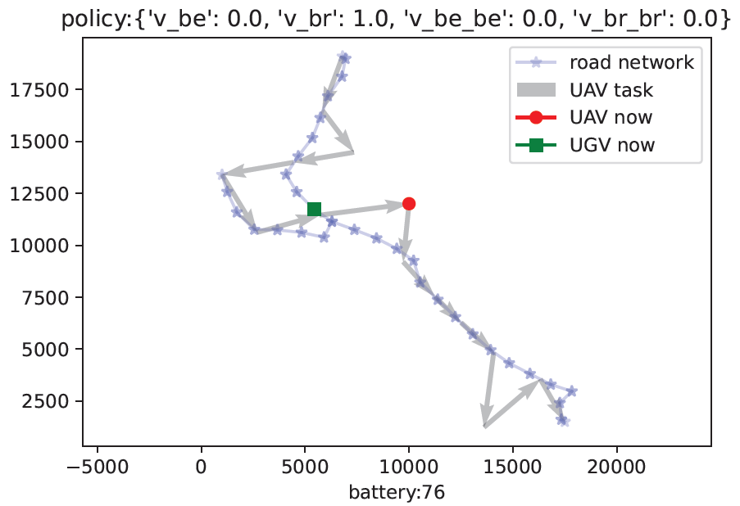
Rendezvous case study
One sample trajectory for c = 0.1
Notes:
Parameters, Input map: some file
Continuous state
Collision state penalty?

Slide 50
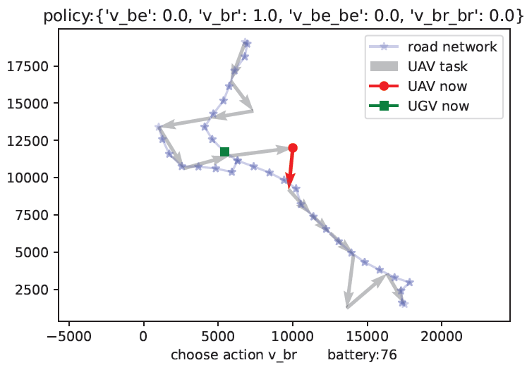
Rendezvous case study
One sample trajectory for c = 0.1
Notes:
Parameters, Input map: some file
Continuous state
Collision state penalty?

Slide 51
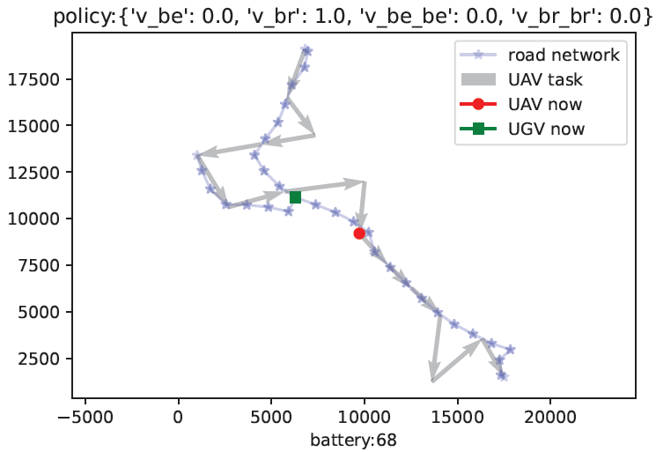
Rendezvous case study
One sample trajectory for c = 0.1
Notes:
Parameters, Input map: some file
Continuous state
Collision state penalty?

Slide 52
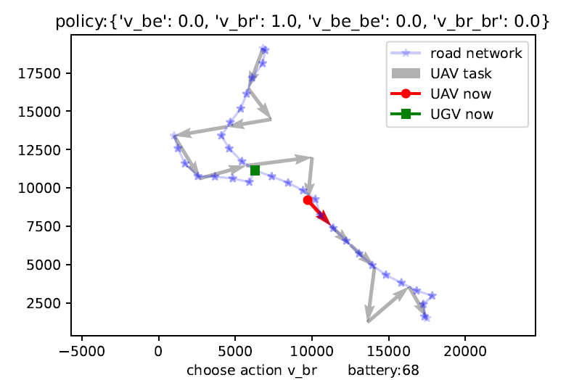
Rendezvous case study
One sample trajectory for c = 0.1
Notes:
Parameters, Input map: some file
Continuous state
Collision state penalty?

Slide 53
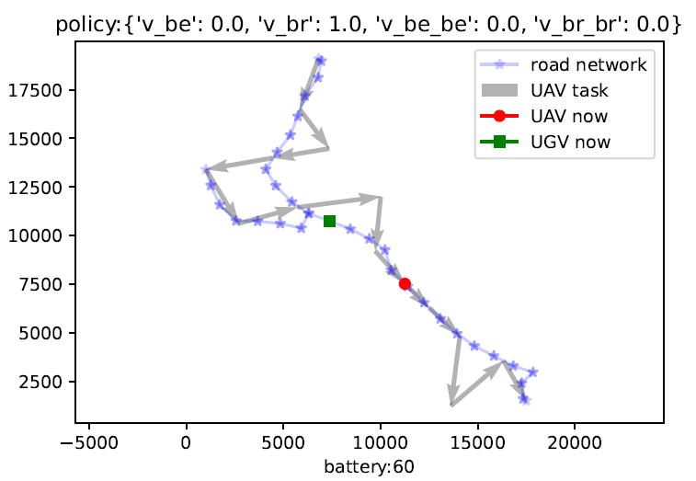
Rendezvous case study
One sample trajectory for c = 0.1
Notes:
Parameters, Input map: some file
Continuous state
Collision state penalty?

Slide 54
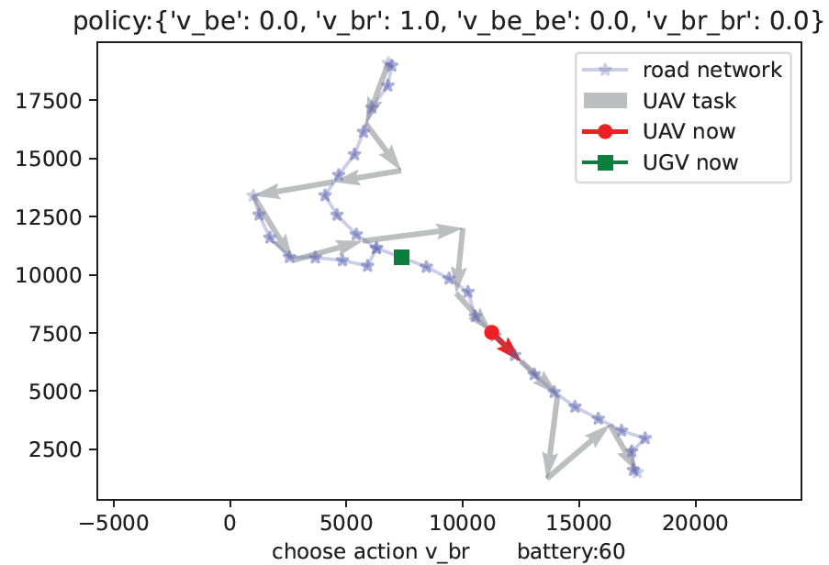
Rendezvous case study
One sample trajectory for c = 0.1
Notes:
Parameters, Input map: some file
Continuous state
Collision state penalty?

Slide 55
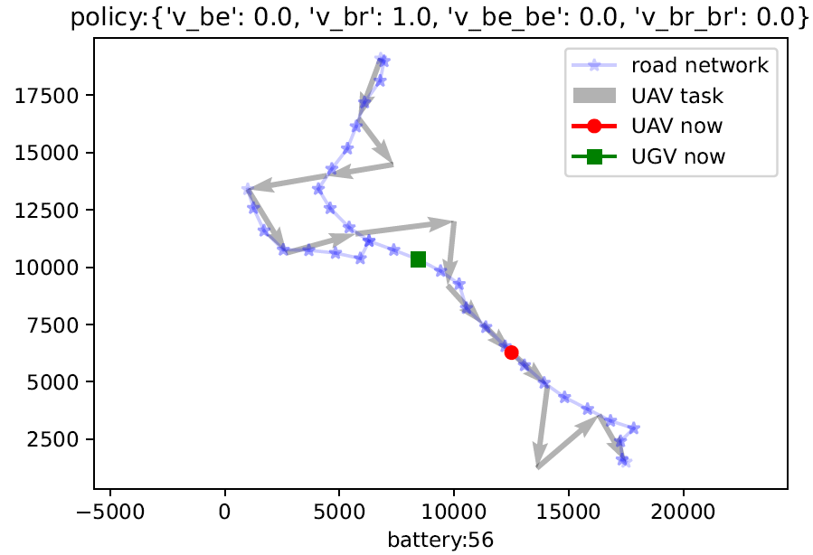
Rendezvous case study
One sample trajectory for c = 0.1
Notes:
Parameters, Input map: some file
Continuous state
Collision state penalty?

Slide 56

Rendezvous case study
One sample trajectory for c = 0.1
Notes:
Parameters, Input map: some file
Continuous state
Collision state penalty?

Slide 57

Rendezvous case study
One sample trajectory for c = 0.1
Notes:
Parameters, Input map: some file
Continuous state
Collision state penalty?

Slide 58

Rendezvous case study
One sample trajectory for c = 0.1
Notes:
Parameters, Input map: some file
Continuous state
Collision state penalty?

Slide 59

Rendezvous case study
One sample trajectory for c = 0.1
Notes:
Parameters, Input map: some file
Continuous state
Collision state penalty?

Slide 60

Rendezvous case study
One sample trajectory for c = 0.1
Notes:
Parameters, Input map: some file
Continuous state
Collision state penalty?

Slide 61

Rendezvous case study
One sample trajectory for c = 0.1
Notes:
Parameters, Input map: some file
Continuous state
Collision state penalty?

Slide 62

Rendezvous case study
One sample trajectory for c = 0.1
Notes:
Parameters, Input map: some file
Continuous state
Collision state penalty?

Slide 63
Rendezvous case study
Energy model will decide the total travel time
Notes:
Parameters, Input map: some file
Continuous state
Collision state penalty?

Slide 64


Rendezvous case study
Energy consumption model
Notes:
Parameters, Input map: some file
Continuous state
Collision state penalty?

Slide 65

Rendezvous case study
Energy consumption model
Notes:
Parameters, Input map: some file
Continuous state
Collision state penalty?

Slide 66
Discussion
UAV and UGV start here
UAV and UGV start here
Modifications to the instance
More analysis needed
Notes:
Parameters, Input map: some file
Continuous state
Collision state penalty?

Slide 67


Problem
Gap in objective function
Notes:
Parameters, Input map: some file
Continuous state
Collision state penalty?

Slide 68
Option 1
TSP
CMDP
+
+
Hardware demonstration
Unity demonstration
Option 2
Task planning
CMDP
Notes:
Parameters, Input map: some file
Continuous state
Collision state penalty?

Slide 69
Intro
A: minmax latency
G: CMDP a complete example minmax latency

Slide 70


An intuitive example based on UAV task

Slide 71


Slide 72


Slide 73


Slide 74

Notes:
Parameters, Input map: some file
Continuous state
Collision state penalty?

Slide 75


Slide 76

Notes:
Presented in the Discussion session

Slide 77
Running time
Notes:
12 min
20 min
1.81 s

